Slide 1
AIRCRAFT EVENT ANALYSIS: IDENTIFYING LOW-RISK AIRCRAFT FOR BUSINESS EXPLORATION
A Data driven approach to supporting strategic decisions
By Beverlyne Langat

Slide 2

Overview
The primary goal of this project is to evaluate aviation risk to identify aircraft that are low-risk for the company to purchase and operate. By analyzing historical aviation event data, this analysis will provide actionable insights into aircraft safety, operational reliability, and risk factors associated with different aircraft models and flight operations.

Slide 3
Problem Statement
Understanding Aviation Risks
Context: Our company is diversifying its portfolio by expanding into the aviation industry, aiming to purchase and operate aircraft for commercial and private use.
Problem: Limited knowledge of potential risks in aircraft operations.
Key Question: Which aircraft types pose the lowest risk for our business?

Slide 4

Goal
Objective of the Analysis
To identify aircraft makes and models with the lowest risk profiles.
To provide actionable insights to support the selection of aircraft for purchase.
To use the historical aviation event data to guide decisions.

Slide 5
Data Overview
Data Used for Analysis
Dataset Source: Historical aviation event data sourced from a published kaggle repository. The data source
Key Features:
Aircraft Information: Make, model, purpose of flight.
Event Details: Date, location, weather, phase of flight.
Injury and Damage Data: Fatalities, injuries, severity, aircraft damage.
Data Cleaning: Missing value handling, duplicates removed, numerical fields aggregated.

Slide 6

Analysis Steps
Our Analytical Approach
In general, a couple of python libraries(pandas, seaborn, numpy, matplotlib) was used for the analysis and visualization part of this project. Tableu was also used to create more interactive visualizations.
Data Exploration:
- Distribution of events by make, model, and purpose.
- Trends in event frequency over time.
2. Visualization:
- Bar charts for event frequency by make/model.
- Line charts for events per year.
- Heatmaps for correlations between flight phase, weather, and severity.
3. Insights:
- Focus on aircraft types with high safety records and low incidents.

Slide 7
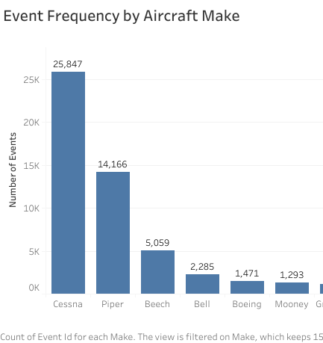
Observations
Key Findings
Most Common Aircraft
Top 15 aircraft makes account for 68.44% of the number of incidents.

Slide 8
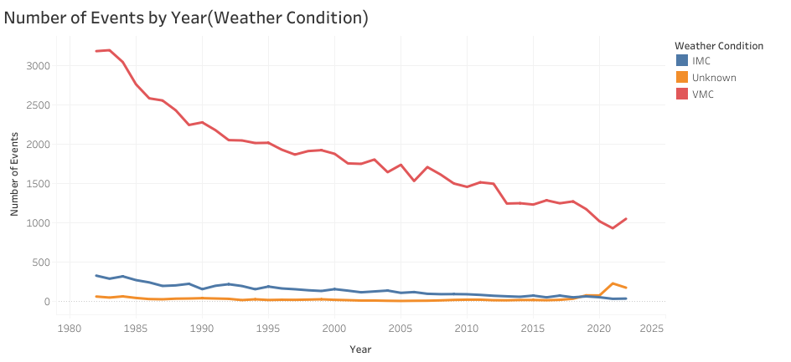
Observations
Key Findings continuation
Event Trends
The number of incidents reduce across years but are more under VMC(visual meteorological conditions) weather conditions.

Slide 9
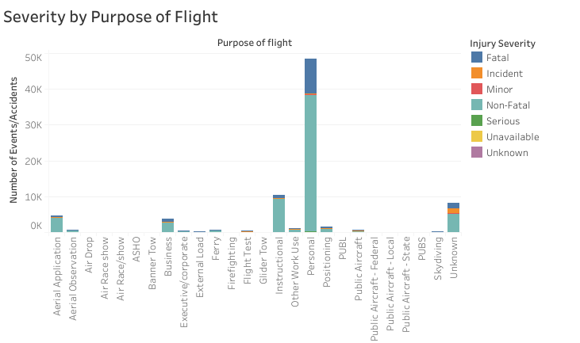
Observations
Key Findings continuation
Purpose of Flight
Personal flights show more incidents compared to business or commercial flights.

Slide 10
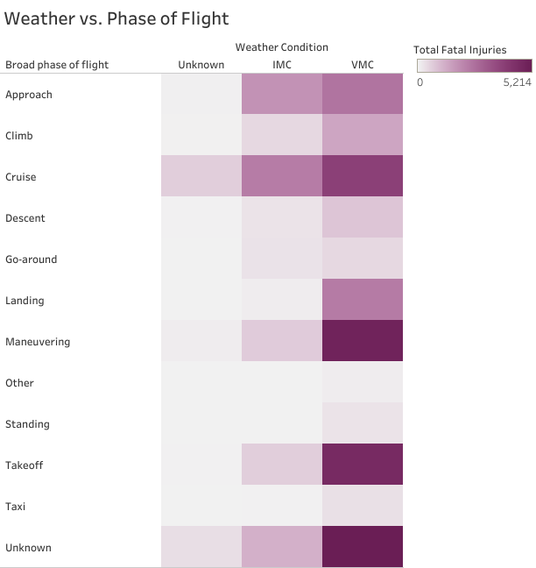
Observations
Key Findings continuation
Severity Patterns
Higher fatalities during Maneuvering and Takeoff flight phases and VMC weather conditions.

Slide 11

Recommendations
Recommendations to Stakeholders
Aircraft Selection
Focus on makes/models with lower incident rates and less severe outcomes . Avoid models with high and severe incidents like Cessna and Piper.
Safety Protocols
Invest in training for critical flight phases (e.g., takeoff, landing).
Weather Preparedness
Enhance pilot training for VMC(visual meteorological conditions).
Data Monitoring
Establish a system that will continually monitor and evaluate the aviation risks over time.

Slide 12
Conclusion
Data-driven insights help mitigate risks in aircraft selection and operation.
Prioritizing safety-focused decisions will support long-term business success in aviation.
A foundation for ongoing analysis to adapt to future challenges.

Slide 13
The End

